Slide 1
SIGN LANGUAGE TO SPEECH
Under the Esteemed Guidance Of
Mrs. CH.B.V.Durga
Associate Professor
Submitted by
IV CSE(AI&ML)
Ms. Sakam Rani (20KT1A4247)
Mr. Rakesh (21KT5A4206)
Ms. Y Hannah (20KT1A4263)
Ms. Yannam Hema (20KT1A4262)

Slide 2
ABSTRACT
The sign language to speech project aims to create a system that uses the Random Forest algorithm to translate gestures from sign language into spoken Telugu, bridging the communication gap between normal people and who can not speak or dumb people.
Using a machine learning technology called the Random Forest algorithm will recognize and translate the sign language motions, generating Telugu speech output, promoting inclusivity and accessibility for individuals who can not speak for themselves. An existing models didn’t give the appropriate result. So, overcome those drawbacks to creating a optimize model.
The project aims to provide real-time translation and seamless communication for individuals who are dumb or deaf-mute, potentially exceeding current accuracy standards.

Slide 3
INTRODUCTION
This project aims to bridge the communication gap between disabled individuals (dumb people) and normal people by developing a system that translates sign language gestures into spoken Telugu language.
The system uses the Random Forest algorithm to accurately interpret sign language gestures, enabling real-time translation of sign language, promoting seamless communication between sign language users (dumb people) and those who can speak.
The project aims to improve the quality of life and effective communication in order to enhance the interaction or social involvement of people who are dumb or deaf-mute.

Slide 4
Random Forest Algorithm
Random Forest is a popular ensemble learning algorithm that is widely used for both classification and regression tasks.
Random Forest Algorithm Working:
Initialization: Start with a dataset that contains images.
Random Sampling: Randomly select a subset of the dataset with replacement to create multiple subsets of data.
Tree Construction: Build decision trees on each subset using randomly selected features.
Ensemble Learning: Create an ensemble of decision trees.
Voting: Combine predictions from all trees for final output.
Output: Return the final prediction as the classifier's output.
Evaluation: Assess the performance of the Random Forest classifier using metrics such as accuracy, precision, recall, or F1-score.

Slide 5
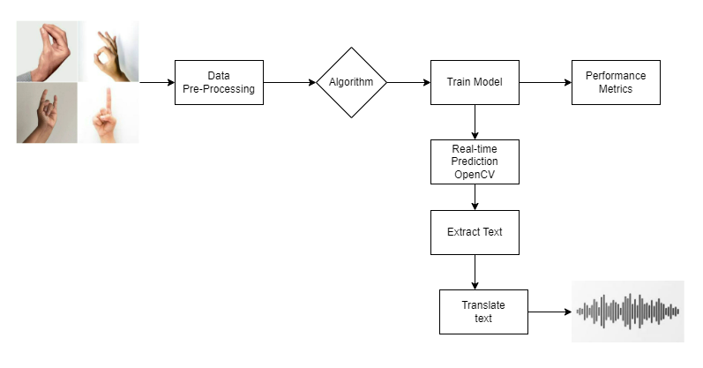
Design

Slide 6
Proposed Methodology
To develop a sign language to speech system, The first step is gathering a dataset of pictures of sign language motions. From these images, we extract hand coordinates using the MediaPipe library. The data is then recorded in a dictionary format along with class labels after the retrieved coordinates are preprocessed and tagged with the appropriate sign language motions. The next stage is to use the preprocessed data to train a machine learning model, like a Random Forest Classifier. To make sure the model is effective at identifying sign language motions, we assess its accuracy on a validation set. When the trained model reaches a high enough accuracy level, it is saved in a pickle file for later use.

Slide 7
Proposed Methodology (Cont..)
Next, we build the system in real-time by utilizing OpenCV to record a live video stream and training the model to predict sign language movements in real-time. Characters are taken out of the gestures and combined to form words or sentences. We translate the identified text from English to Telugu or another target language using the Googletrans library. In order to transform the translated text into speech and provide the meaning of the identified sign language movements in the required language, such as Telugu, we finally use the GTTS (Google Text-to-Speech) library. This all-inclusive method bridges the gap between spoken and sign language for those with hearing difficulties, enabling them to communicate effectively.

Slide 8
MediaPipe Library Extract Hand Coordinates
Train Model using Random Forest
Collecting Images
(Dataset)
Save Coordinates in Pickle
File
Recognize gesture and Form
sentences
Real Time Prediction using OpenCV
Save Trained Model in Pickle File
Calculate Accuracy
Translte English to Telugu using googletrans
Convert Telugu Text to Speech using Gtts(Google Text-to-Speech) library
Telugu Meaning to audio (speech)

Slide 9
CONCLUSION
In order to enable smooth communication between those who use sign language (dumb people), our sign language to speech project successfully built a system that transforms sign language movements into spoken Telugu language. Through the use of the Random Forest algorithm for speech synthesis and gesture recognition, we have developed an approachable solution that encourages accessibility and inclusivity for individuals who are dumb or mute. In the end, this approach improves this demographic's quality of life by fostering understanding and social connection in addition to addressing communication hurdles.

Slide 10
Thank You

